Slide 1
Spring Boot
Pet Park Locations: "Create Contributor" operation

Slide 2
In this video...
Explain the parts of a Spring Boot application
Code the classes needed to perform the "Create Contributor" operation
Develop JSON that will be used to create a contributor
Explain the HTTP POST method
Add transaction management

Slide 3
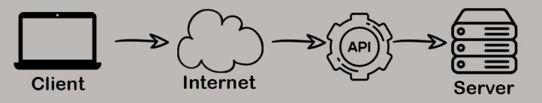
What is an API?
An API (Application Programming Interface) is a set of rules that allows software applications to communicate with each other
APIs are like messengers that deliver requests and responses between applications
We’ll use Sprint Boot to build a Web-based API application
Web-Based API Backend Application

Slide 4
The anatomy of a Spring Boot application
Controller (handles HTTP requests)
Service (manages business logic)
DAO (interacts with database)

Slide 5
The anatomy of a Spring Boot application
Controller (class)
ParkController.java
Service (class)
ParkService.java
DAO (interface)
ContributorDao.java

Slide 6
Once the Java is created...
Use a REST client to send JSON to the running application
We will use Advanced REST Client (ARC) from MuleSoft

Slide 7
A look at JSON
JSON (JavaScript Object Notation) is a standard, human-readable format for storing and exchanging data. It's commonly used in web applications and APIs.
JSON is made up of key-value pairs
Keys are strings in quotation marks
Values can be strings, numbers, arrays, objects, or the literals false, true, and null
Key-value pairs are separated by commas
An object begins with a left brace and ends with a right brace
An array begins with a left bracket and ends with a right bracket
JSON:
{
"contributorName": "Sandy Blotts",
"contributorEmail": "sandy@blotts.r.us"
}

Slide 8
JSON vs. Java
Must look exactly like the receiving class
JSON:
{
"contributorName": "Sandy Blotts",
"contributorEmail": "sandy@blotts.r.us"
}
Java:
class ContributorData {
Long contributorId;
String contributorName;
String contributorEmail;
}

Slide 9
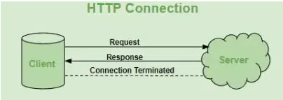
A look at HTTP
HTTP is an abbreviation for Hypertext Transport Protocol
HTTP is just text sent over the Internet
HTTP consists of a request and a response

Slide 10
HTTP Request
Request Line
Request Headers
Request Body (JSON)

Slide 11
Request Line
VERB + URI + HTTP Version
GET /pet_store HTTP/2.0
POST /pet_store HTTP/2.0
Common HTTP Verbs (CRUD):
POST (Create)
GET (Read)
PUT (Update)
DELETE (Delete)

Slide 12
Request Headers
Describe the request and allowed response format(s)
Accept: application/json
Content-Type: application/json

Slide 13
Request Body
Used for POST (Create) and PUT (Update)
Written as valid JSON
Also called the request payload

Slide 14
HTTP Response
Status Line
Response Headers
Response Body (JSON)

Slide 15
Response status line
HTTP version + status code + reason
HTTP/2.0 200 OK
HTTP/2.0 404 Not Found
HTTP/2.0 409 Conflict
https://en.wikipedia.org/wiki/List_of_HTTP_status_codes

Slide 16
Response headers and body
Very similar to request headers and body
Response headers may be different than request headers, but they are still key: value pairs
Body (payload) is JSON

Slide 17
URI / URL?
URI (Uniform Resource identifier) - Acts as a general identifier for a resource, not necessarily providing a way to access it directly.
URL (Uniform Resource Locator) - Provides the complete address to locate and access a resource on the web.
Example:
URI: “/users/123" - Identifies a user with ID 123 within the API
URL: "https://api.example.com/users/123" - The full address to access the user details with ID 123 on the web

Slide 18
A look at REST
REST is an abbreviation for Representational State Transfer
Data and functionality are considered resources and are accessed using Uniform Resource Identifiers (URIs)
The resources are acted upon by using a set of simple, well-defined operations
HTTP is the most used protocol
A Web API (or Web Service) conforming to the REST architectural style is called a REST API (or RESTful API)
REST defines a consistent and uniform interface for interactions between clients (front-ends) and servers (Back-ends)
For example, the HTTP-based REST APIs make use of the standard HTTP methods (GET, POST, PUT, DELETE, etc.) and the URIs (Uniform Resource Identifiers) to identify resources

Slide 19
Setting up
We will create Data Transfer Objects (DTOs) for the request and response
Jackson (JSON generator) freaks out with the recursive nature of entities:
class Contributor {
List<PetStore> petStores;
}
class PetStore {
Contributor contributor;
}
Jackson goes BOOM!

Slide 20
The POST request
Use Advanced Rest Client (ARC) to send POST request with JSON payload to the service running in Eclipse:
http://localhost:8080/pet_park/contributor
A POST request returns status 201 (Created) if successful

Slide 21
Transaction management
In a transaction, a group of SQL statements will either all succeed or all fail – no partial success
Transactions are started by adding @Transactional to a public method in the service class
If an exception is thrown the transaction "rolls back"
If an exception is not thrown the transaction is "committed"

Slide 22
Let's code it!

